Slide 1
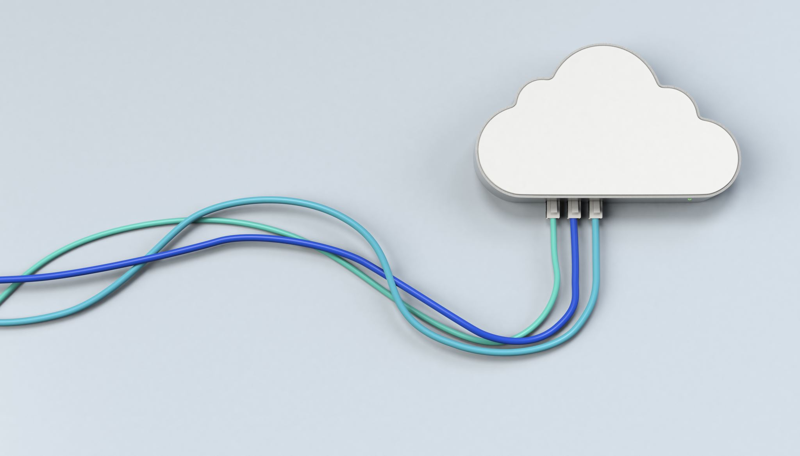
CHAPTER 2 Evolution and Enabling Technologies
|Cloud Computing

Slide 2
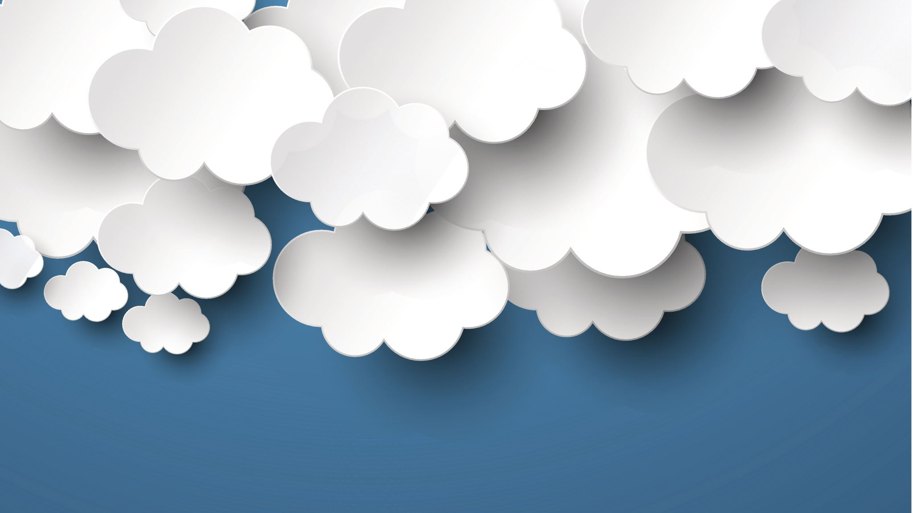
Evolution & ENABLING of CLOUD Computing
Gradual Development
Cloud computing is not an abrupt innovation but a result of decades of advancements in computing technology.
Historical Context:
The idea of cloud computing dates back to the 1960s.
John McCarthy's Vision: He suggested that "computation may someday be organized as a public utility."
Technological Advancements:
Over time, progress in hardware, communication, and web-based software architecture enabled the realization of cloud computing.
The development of the Internet played a crucial role in changing how computing services were delivered.

Slide 3
Evolution & ENABLING of CLOUD Computing
Overcoming Limitations:
Earlier technological constraints prevented cloud computing from becoming a reality.
Advancements in associated fields overcame these limitations, making cloud computing possible.
Evolution of Computing Models:
The chapter traces the evolution of cloud computing through stages:
Centralized Computing
Client-Server Computing
Distributed Computing
Grid Computing
Cloud Computing
Cloud as a Public Utility:
Cloud computing has finally realized the vision of computing as a public utility, providing on-demand services to users.

Slide 4
Evolution of CLOUD Computing
Several decades of research, particularly in the domain of parallel and distributed computing, have paved the way for cloud computing

Slide 5
Evolution OF CLOUD COMPUTING
Mainframe Architecture: In the 1970s, organizations used expensive, large mainframes for tasks like payroll management. Time-sharing systems allowed multiple users to access the same computer resources concurrently, reducing the need for multiple mainframes. Dumb terminals were used to access the mainframes remotely.
Intelligent Terminal and Client-Server Computing: As processing demands grew, technologists developed intelligent terminals (or client systems) capable of minimal processing. This led to client-server computing, where the load was partially shifted from servers to clients.
PC Revolution: The introduction of personal computers (PCs) in the 1970s further reduced dependence on mainframes. Organizations could perform all computing tasks locally on affordable PCs, which decreased the need for time-sharing systems.

Slide 6
Evolution OF CLOUD COMPUTING
Network of PCs and Peer-to-Peer Computing: As PCs became widespread, the need for direct communication between distant computers emerged. The development of LAN and WAN technologies enabled peer-to-peer (P2P) computing, allowing PCs to act as both clients and servers, decentralizing control.
Parallel and Distributed Computing: By the 1980s, parallel processing and distributed computing were introduced. Parallel processing allowed multiple processors to work on a task simultaneously, while distributed computing combined multiple systems to create a powerful computing network.
Cluster Computing: Clusters of interconnected computers performing similar tasks provided faster execution by distributing jobs across multiple nodes. Clustering also introduced the concept of resource pooling, improving reliability through redundancy.

Slide 7
Evolution OF CLOUD COMPUTING
Grid Computing: Grid computing took cluster computing a step further by decentralizing control and allowing nodes to perform tasks without a central 'head.' This architecture could scale across geographic locations and accommodate heterogeneous systems.
Hardware Virtualization: Virtualization allowed the decoupling of software systems from physical hardware, enabling dynamic resource scaling. This introduced the concept of virtual machines (VMs), which could simulate physical systems and manage resources more flexibly.
Advancement in Web Services: The growth of web services, particularly with Web 2.0, facilitated group collaboration over the web. This enabled real-time collaboration across geographically dispersed users, making it easier to integrate and share data across platforms.

Slide 8
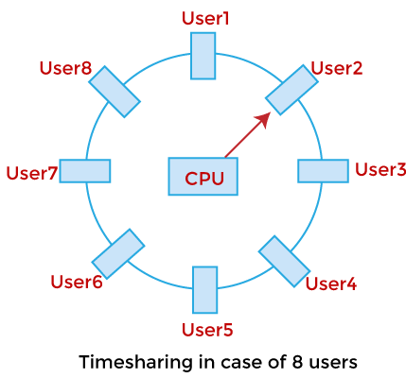
Evolution OF CLOUD COMPUTING : Mainframe Architecture
Mainframe Architecture: Introduction of Time-Sharing System
Early computing (1970s) used mainframes for data processing (e.g., payroll).
Time-sharing allowed multiple users to access a single mainframe.
Dumb terminals enabled remote access to centralized systems, but without local processing power.
1970s

Slide 9
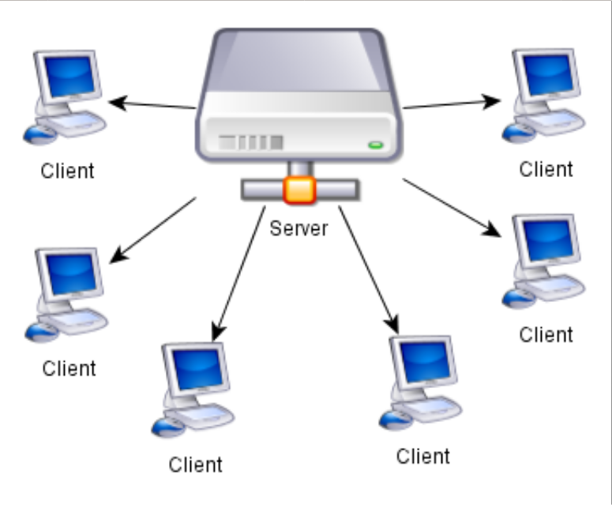
Evolution OF CLOUD COMPUTING : Intelligent Terminal
Intelligent Terminal: Beginning of Client-Server Computing
Dumb terminals were limited in handling concurrent tasks.
Intelligent terminals with some processing power emerged due to low-cost microprocessors.
This was the beginning of client-server computing, reducing load on central servers by distributing tasks.
1970s

Slide 10
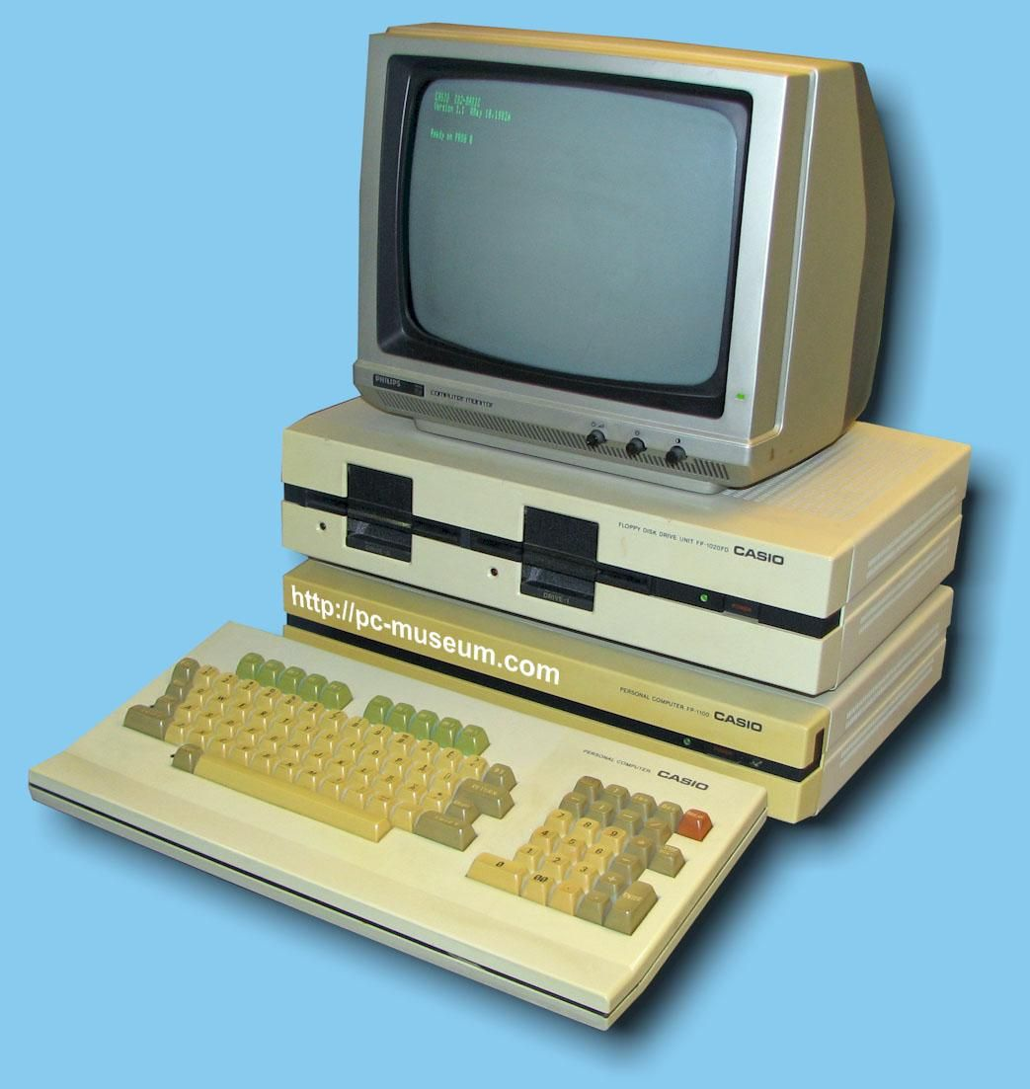
Evolution OF CLOUD COMPUTING : The PC Revolution
The PC Revolution: Scope for Computing Everything Locally
Microprocessors enabled personal computers (PCs) to perform tasks locally.
PCs were affordable, reducing reliance on expensive mainframe systems.
This allowed organizations to handle more computing tasks internally.
Mid 1970s

Slide 11
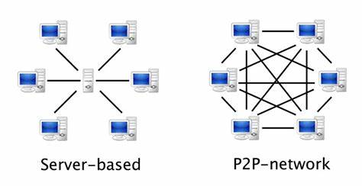
Evolution OF CLOUD COMPUTING : PEER TO PEER
Network of PCs: Emergence of Direct or Peer-to-Peer Communication
Organizations installed multiple PCs, but they couldn't communicate directly.
Network communication (LAN, WAN) solved this issue, enabling PCs to communicate without needing a central server.
Peer-to-peer (P2P) computing emerged, decentralizing control.

Slide 12
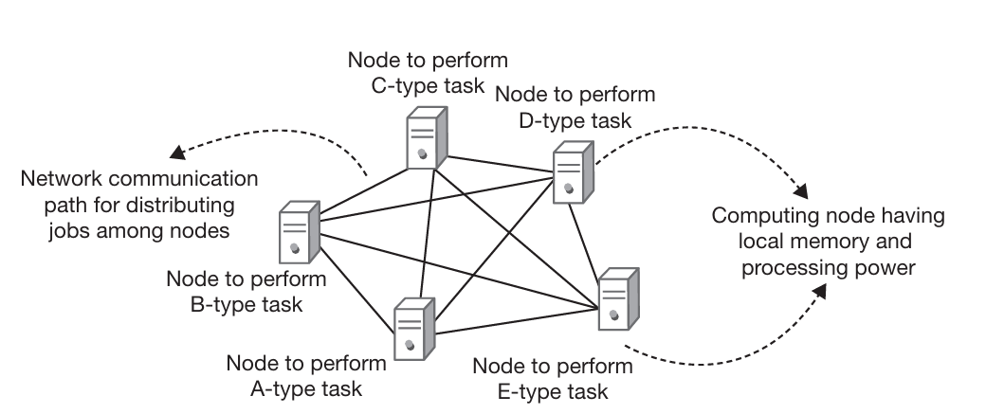
Evolution OF CLOUD COMPUTING : DISTRIBUTED COMPUTING
Fast Network Communication: Laid the Way for Distributed Computing
Parallel processing (multiple processors solving a task) was a key innovation.
Distributed computing extended this concept, allowing multiple computers to work together as one system.
Faster network communication enabled distributed computing to function efficiently.
1980s

Slide 13
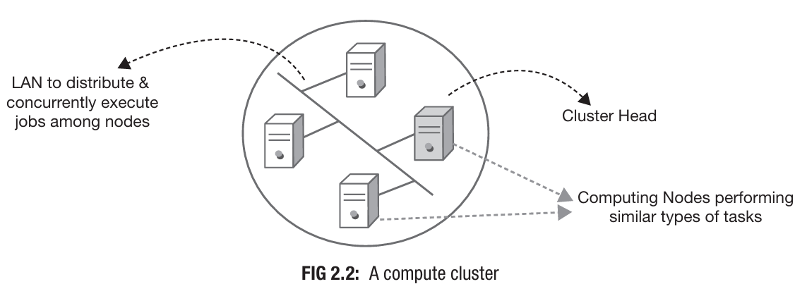
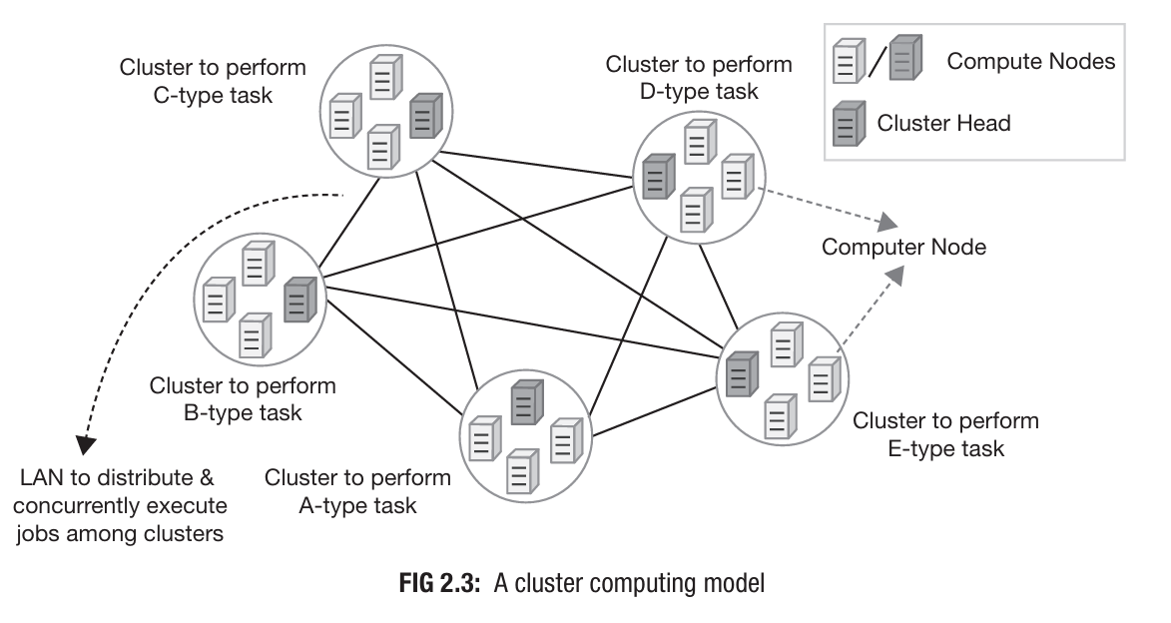
Evolution OF CLOUD COMPUTING : Cluster Computing
Cluster Computing: Creation of Resource Pool
Clustering allowed multiple nodes to work together, appearing as a single system.
Nodes shared computing tasks, creating a more reliable system through redundancy.
Cluster computing enabled the pooling of resources for faster and more reliable execution.

Slide 14
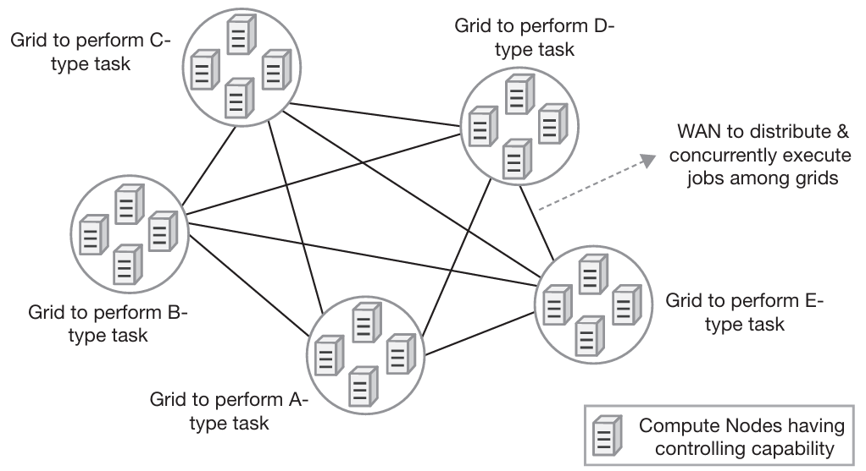
Evolution OF CLOUD COMPUTING : Grid Computing
Grid Computing: Decentralization of Control
Grid computing removed the dependency on a single cluster head, decentralizing control.
It introduced heterogeneous systems (different hardware/software) into the same computing grid.
Grid computing scaled distributed systems across geographic locations and administrative domains.
Early 1990s

Slide 15
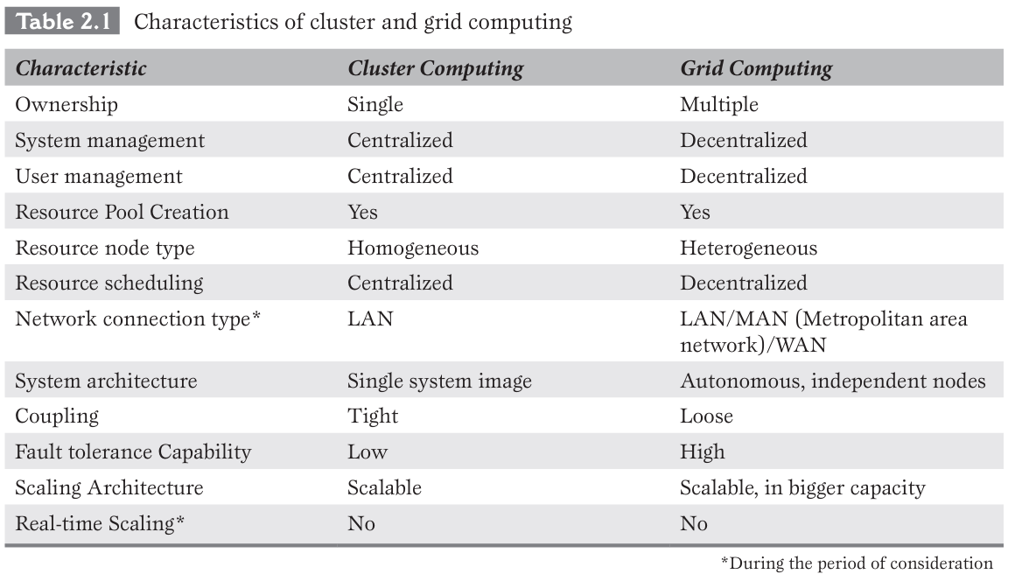
Evolution OF CLOUD COMPUTING : CLUSTER VS Grid Computing

Slide 16
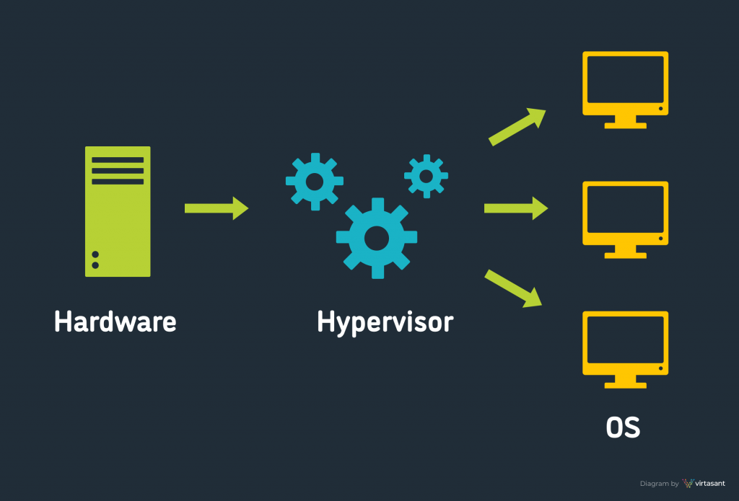
Evolution OF CLOUD COMPUTING : Hardware Virtualization
Hardware Virtualization: Weapon for Designing Dynamic Computing Systems
Virtualization decoupled software from physical hardware, enabling dynamic resource allocation.
Virtual machines (VMs) allowed real-time scaling, increasing system flexibility and scalability.
Virtualization was a key factor in the growth of cloud computing, enabling efficient resource management.

Slide 17
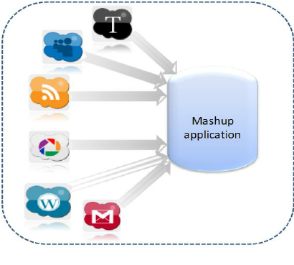
Evolution OF CLOUD COMPUTING : Advancement in Web Services
Advancement in Web Services: Ease in Group Collaboration
Web services enabled real-time collaboration across distributed systems.
Web 2.0 and Mashup technologies made it easier to combine data from different platforms and share user-generated content.
This facilitated large-scale collaboration over the internet.
2002

Slide 18
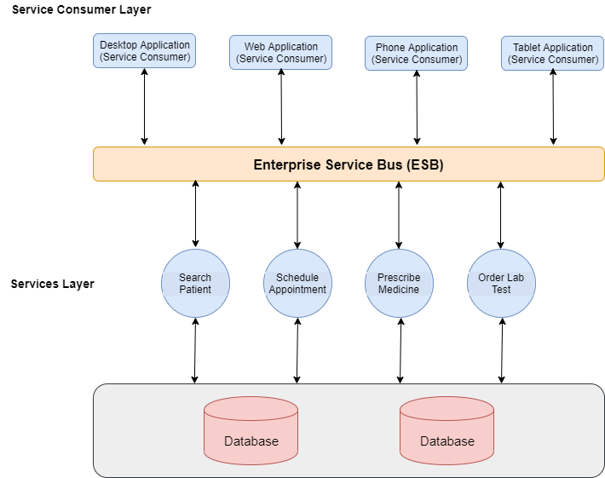
Evolution OF CLOUD COMPUTING : Service-Oriented Architecture
SOA (Service-Oriented Architecture): Flexible Software Design Model
SOA allowed the creation of loosely coupled services that could be reused across applications.
Web services integrated these services, making it easier to develop large distributed applications.
This model supported cloud service delivery.

Slide 19
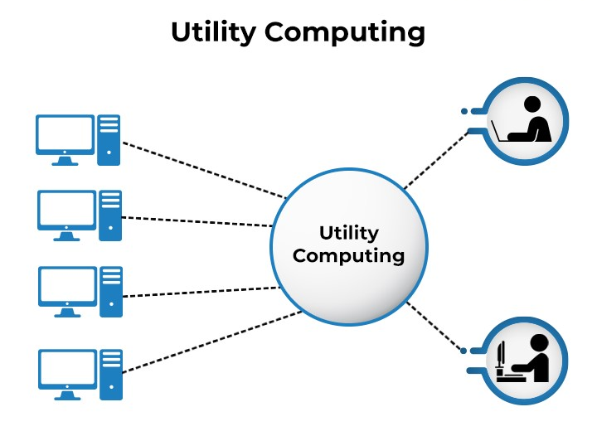
Evolution OF CLOUD COMPUTING : Utility Computing
Utility Computing: A Pay-as-You-Go Model
Utility computing introduced the concept of delivering computing resources as a service, similar to utilities like water or electricity.
Users paid only for what they used, making computing more cost-efficient.
This model laid the foundation for cloud service models (IaaS, PaaS, SaaS).
Utility Computing is the packaging and delivery of computing resources, similar to traditional public utilities like electricity, water, or telephone. The model follows pay-per-use mode of payment and on-demand service facility.

Slide 20
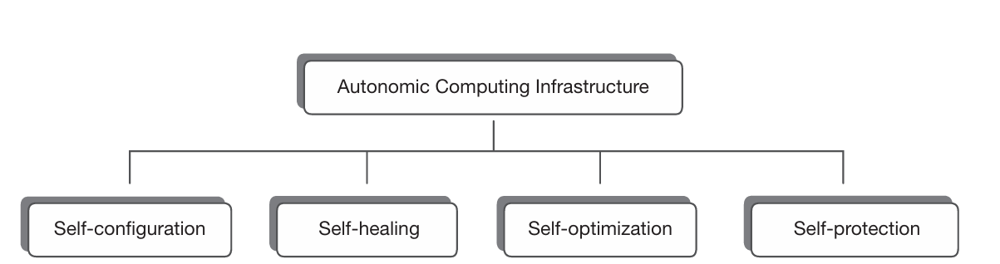
Evolution OF CLOUD COMPUTING : Autonomic Systems
Autonomic Systems: Self-Management in Computing Systems
Autonomic systems were designed to manage themselves without human intervention.
They handled monitoring, resource optimization, and recovery autonomously.
This concept was crucial for the development of self-scaling and self-healing cloud systems.

Slide 21
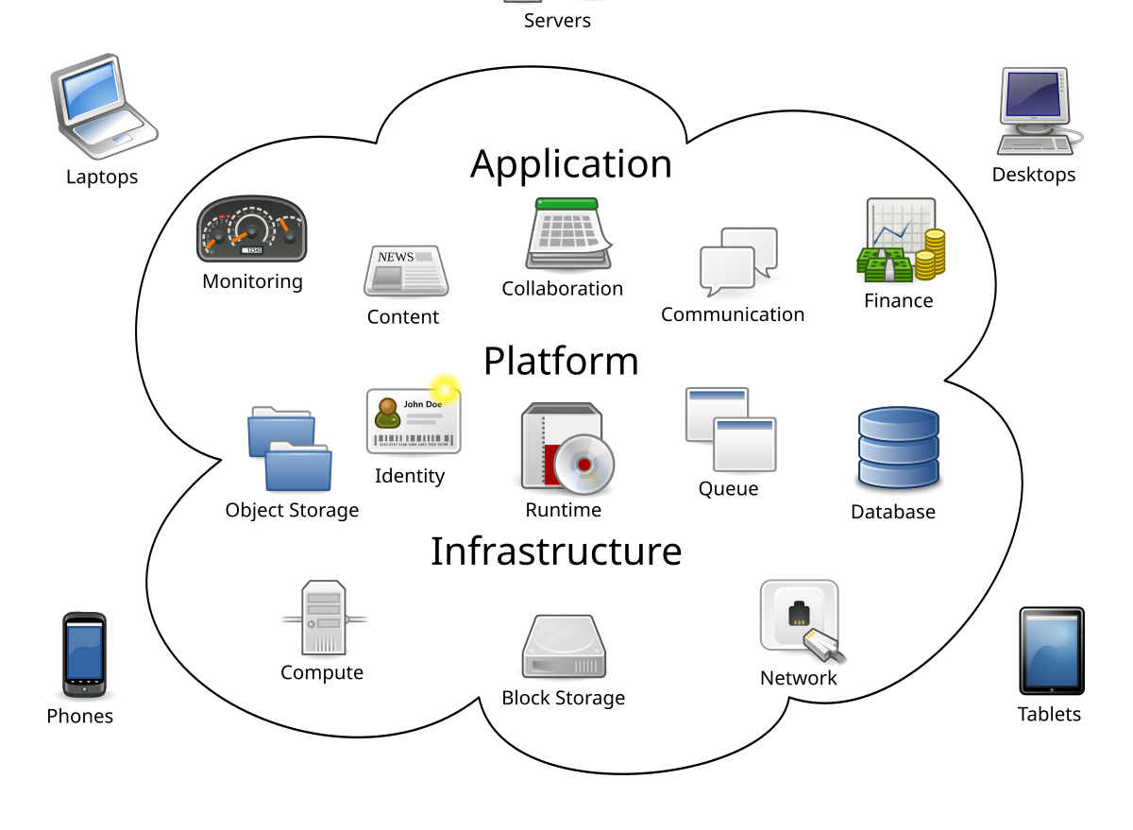
Evolution OF CLOUD COMPUTING : Cloud Computing
Emergence of Cloud Computing
Cloud computing is a combination of advancements in virtualization, distributed systems, grid computing, and utility computing.
It allows on-demand access to shared computing resources over the internet.
Cloud computing offers scalability, flexibility, and cost-efficiency, making it a preferred model for modern computing.

Slide 22
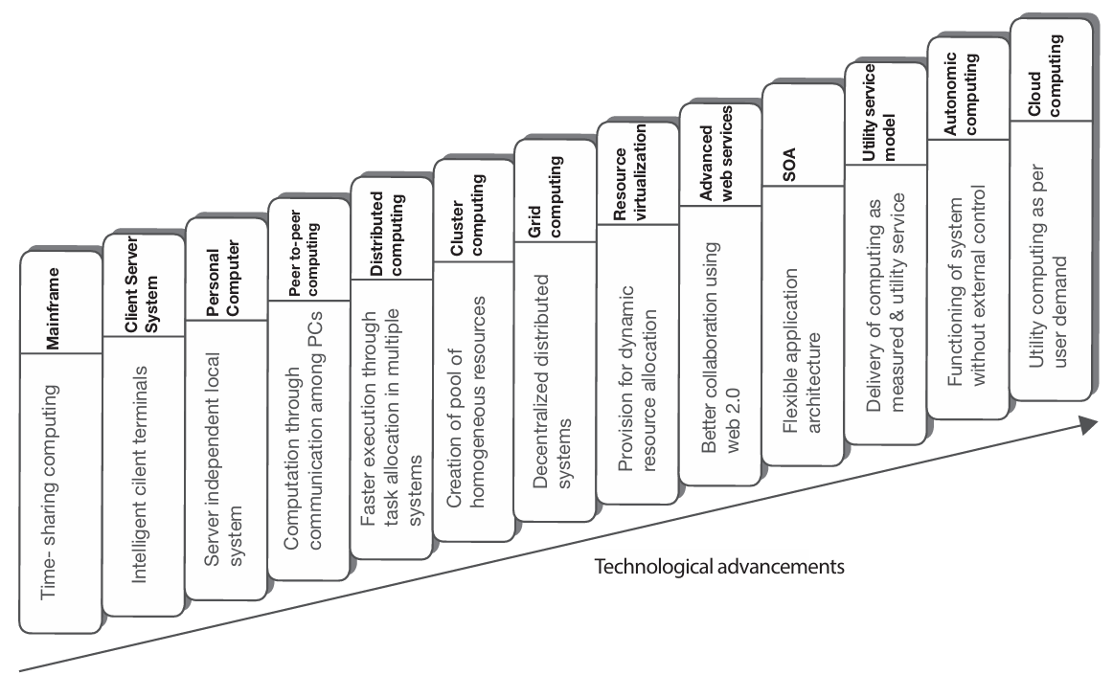
Evolution OF CLOUD COMPUTING

Slide 23
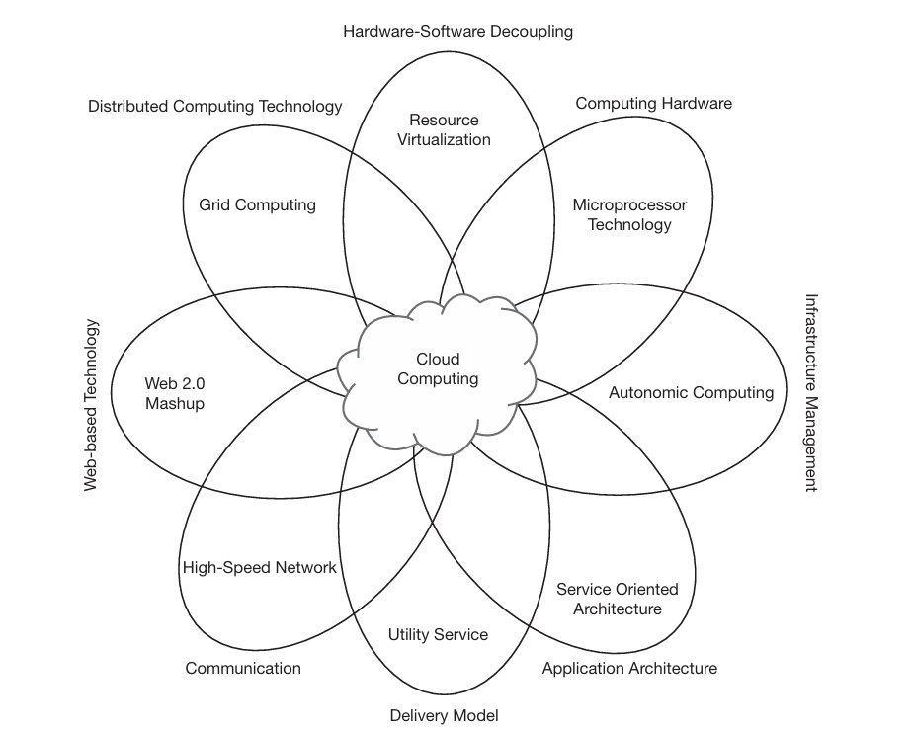
Evolution OF CLOUD COMPUTING

Slide 24
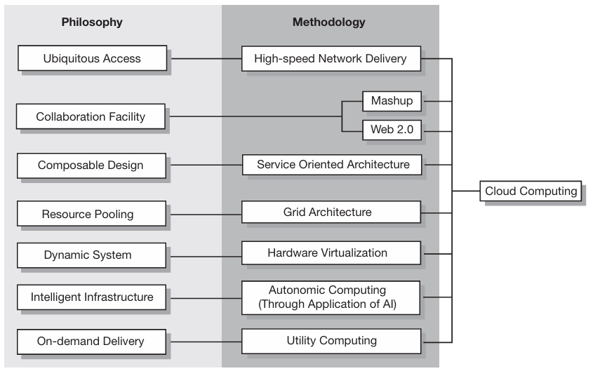
how philosophies have converged into cloud computing
Ubiquitous Presence of Computing:
Computing resources available from any location, at any time.
Achieved through cloud infrastructure providing remote access and multi-device support.
Collaboration Among Users:
Cloud platforms enable real-time collaboration across different locations.
Implemented via tools like Google Docs, Microsoft 365, and collaborative software hosted on the cloud.
Composable Design Pattern:
Systems are designed using a service-oriented architecture (SOA).
Components can be reused and recomposed to create flexible applications.
Resource Pooling:
Shared infrastructure to serve multiple users efficiently.
Virtualization technology helps in the pooling of resources for dynamic allocation.
Dynamic System Architecture:
Elastic scaling based on demand without manual intervention.
Enabled by auto-scaling features and load balancing in cloud systems.
Intelligent Infrastructure:
Systems can intelligently manage resources and self-heal.
Achieved through AI-driven operations, automated monitoring, and management.
On-Demand Delivery:
Resources are provided as needed without upfront investments.
Implemented via pay-per-use models and automated provisioning in cloud services.

Slide 25
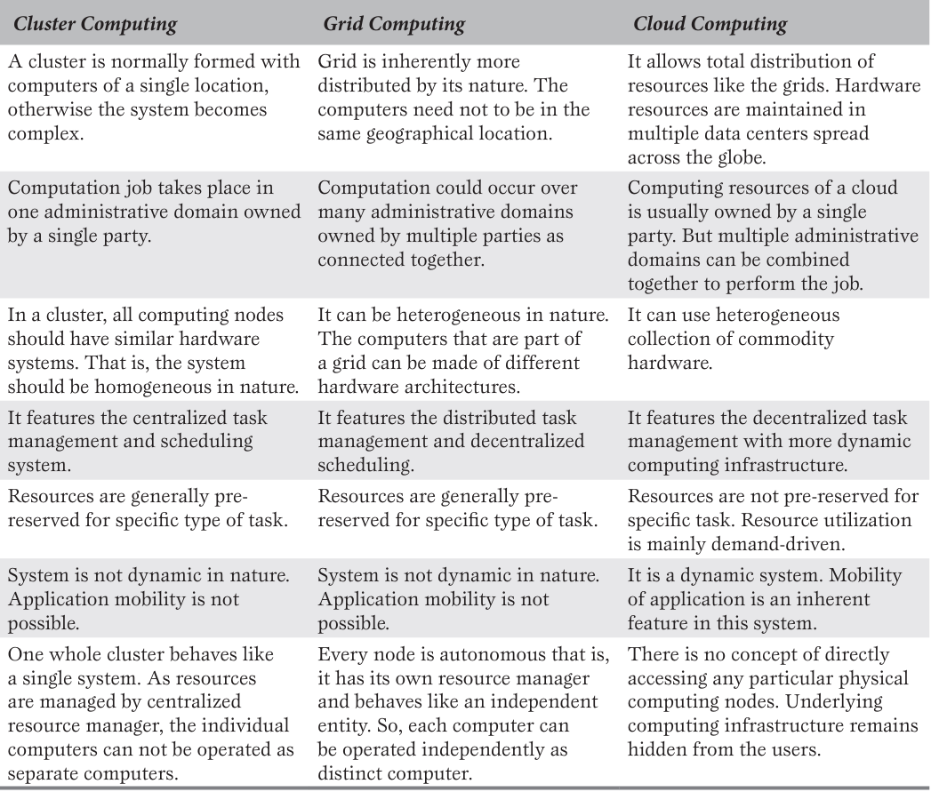
COMPARISON BETWEEN CLUSTER, GRID AND CLOUD COMPUTING

